Slide 1
Poverty & Fast Food
Angie, Brett, CJ, Kenn

Slide 2


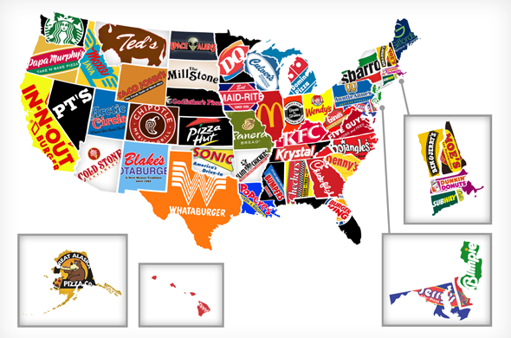

What We Are Looking For
Number of restaurants vs. poverty level
Why understanding this is important
Relationship between unemployment and poverty.
This Photo by Unknown Author is licensed under CC BY-NC-ND

Slide 3

What We Did
Dynamic Map with County and Restaurant Data
Leaflet Dynamic Sidebar
D3 for graphing
API to Obtain Data
Splinter to Obtain Scraped Data
PyMongo to Transfer Data to Mongo DB
This Photo by Unknown Author is licensed under CC BY-SA-NC

Slide 4
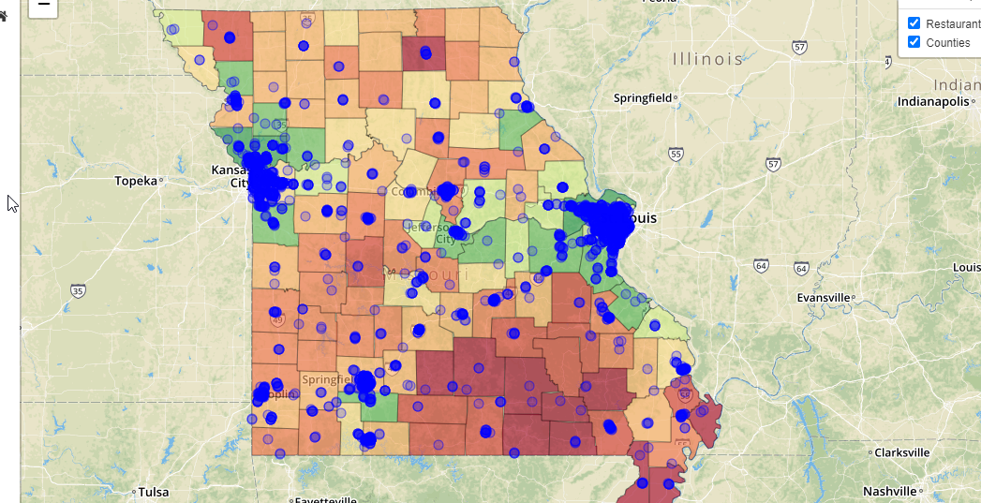
Data ETL
Map:
Restaurant data was obtained from a Yelp API call
County demographic information for Missouri was obtained from API calls to www.census.gov, data.ers.usda.gov, and www.povertyusa.org
County lines for the dynamic map were obtained from a GeoJSON from https://eric.clst.org/tech/usgeojson/
Web-scraping with Splinter:
Scraped current poverty facts
Data Storage in Mongo

Slide 5
Code
D3.js was used to read in csv data and GeoJSON data obtained
The base maps were street map and dark map.
Overlay maps consisted of the location of fast food restaurants in Missouri and the counties of Missouri.
The leaflet plug-in sidebar v2 was incorporated to provide more information about each restaurant.
When the counties layer is activated, they are color coded based on unemployment rate with a legend.
The sidebar was also used to provide the poverty and unemployment information for each county.
D3 for plotting with linear regression analysis

Slide 6
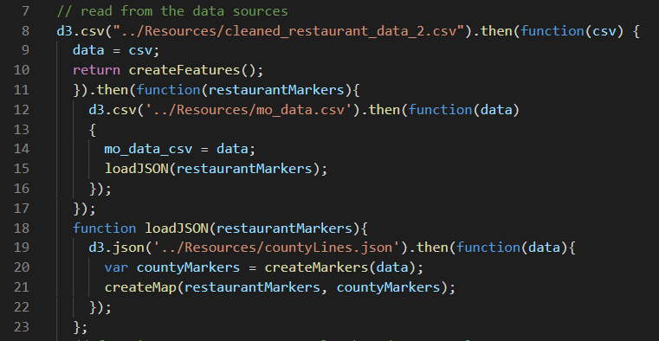
Walk Through of the Code

Slide 7
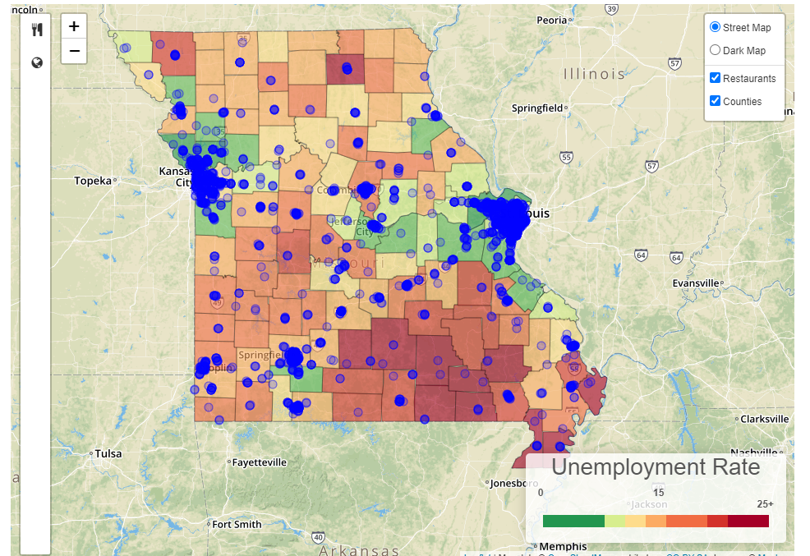
Dynamic Map

Slide 8
References
1. Rhone, A. (2017, December 4). ERS's Updated Food Environment Atlas Shows an Increase in Fast Food Restaurants Between 2009 and 2014. Retrieved May 27, 2020, from http://www.ers.usda.gov/amber-waves/2017/december/ers-s-updated-food-environment-atlas-shows-an-increase-in-fast-food-restaurants-between-2009-and-2014/
2. 1 in 7 Americans Lived in Poverty in 2009 ... - PBS NewsHour. (2010, September 16). Retrieved May 28, 2020, from https://www.pbs.org/newshour/economy/poverty-uninsured-rates-rise-as-recession-continues
3. DeNavas-Walt, C., & Proctor, B. D. (2018, July 25). Income and Poverty in the United States: 2014. Retrieved May 27, 2020, from https://www.census.gov/library/publications/2015/demo/p60-252.html

